Slide 1
Overfitting
Consider the case where true relationship between Y and X is quadratic
$$Y=β_{0}+β_{1}X+β_{2}X^{2}+ε$$
Plot shows full population,
true regression function
ISSU0053 Data Science Dr Phil Lewis

Slide 2
Overfitting
Consider the case where true relationship between Y and X is quadratic
$$Y=β_{0}+β_{1}X+β_{2}X^{2}+ε$$
We only have a sample of the population to work with:
Plot shows 40 points,
true regression function
But we don’t know the true regression function
ISSU0053 Data Science Dr Phil Lewis

Slide 3
Overfitting
Plot shows 40 points,
To find regression function
try fits of different flexibility
(using different polynomials)
ISSU0053 Data Science Dr Phil Lewis

Slide 4
Overfitting
Plot shows 40 points,
fits of different flexibility
Linear fit
Quadratic fit
10th order polynomial fit
ISSU0053 Data Science Dr Phil Lewis

Slide 5
Overfitting
The more flexibility the closer the fit curve can get to the data points.
If the fit function is too flexible, when we optimize it can fit the “noise” component: OVERFITTED
fits of different flexibility
Linear fit
Quadratic fit
10th order polynomial fit
ISSU0053 Data Science Dr Phil Lewis

Slide 6
Overfitting
OVERFITTED
- fit function has fitted the “noise” in the training data.
- Makes it a worse estimate of the true relationship.
- Shows smaller residuals for the training data.
- But may perform poorly on new data where the “noise” on points differs.
fits of different flexibility
Linear fit
Quadratic fit
10th order polynomial fit
If you see much worse fit performance on test data compared to the training data you may have overfitted.
ISSU0053 Data Science Dr Phil Lewis

Slide 7
Overfitting
OVERFITTING
Factors that can lead to overfitting:
fit function is more flexible than the true regression function
few data points
(With lots of data the noise on individual points is less able to influence the fit.)
fits of different flexibility
Linear fit
Quadratic fit
10th order polynomial fit
ISSU0053 Data Science Dr Phil Lewis

Slide 8
Overfitting
very few data points
many data points
Flexible fit gets close to each data point used to train
Flexible fit gives good match to true regression relationship
fits of different flexibility
Linear fit
Quadratic fit
10th order polynomial fit
ISSU0053 Data Science Dr Phil Lewis

Slide 9
Choosing a fit function
Too inflexible a fit function:
Fit function can’t match true relationship.
(e.g. will not get optimal performance even if we estimate the regression function using many data points).
To flexible a fit function:
Fit function may overfit and be influenced by the noise in our training data.
(e.g. will not get optimal performance because we fail to get a good estimate for the true regression relationship).
ISSU0053 Data Science Dr Phil Lewis

Slide 10
Choosing a fit function
Too inflexible a fit function:
Fit function can’t match true relationship.
(e.g. will not get optimal performance even if we estimate the regression function using many data points).
our fit has bias – even estimate on large data set will give residuals that are too big.
To flexible a fit function:
Fit function may overfit and be influenced by the noise in our training data.
(e.g. will not get optimal performance because we fail to get a good estimate for the true regression relationship).
our fit has variability – it is fitting to the noise so our estimated function will vary according to the sample used to train
ISSU0053 Data Science Dr Phil Lewis

Slide 11
Choosing a fit function
Too inflexible a fit function:
Fit function can’t match true relationship.
(e.g. will not get optimal performance even if we estimate the regression function using many data points).
our fit has bias – even estimate on large data set will give residuals that are too big. We have underfitted.
To flexible a fit function:
Fit function may overfit and be influenced by the noise in our training data.
(e.g. will not get optimal performance because we fail to get a good estimate for the true regression relationship).
our fit has variability – we have overfitted and fit is too influenced by noise in data. Our estimated function will vary according to the sample used to train.
bias – variability trade off
ISSU0053 Data Science Dr Phil Lewis

Slide 12
Choosing a fit function
bias – variability trade off
Our example used polynomial fits – higher order polynomial meant more flexibility in the fit.
However in general the flexibility of a multivariate fit depends on the number of fit coefficients (more coefficients to vary = more flexibility)
Therefore the more predictors we include the more flexible our fit is overall.
Adding genuine predictors can improve fit function by reducing bias.
better fit
Adding predictors will also increase the risk of overfitting.
(even if the predictor is genuine)
poorer fit
We need a way to detect overfitting and optimize the trade off between bias and variability…..
ISSU0053 Data Science Dr Phil Lewis

Slide 13
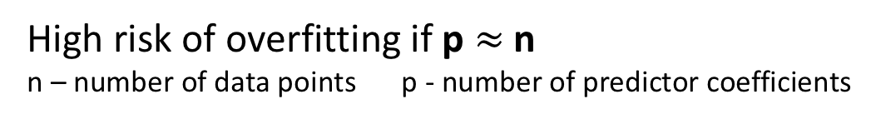
Choosing a fit function
Diagnosing overfitting
Overfitting means we have fitted the noise in the data used to train the model.
High risk of overfitting if p $≈$ n
n – number of data points p - number of predictor coefficients
An overfitted model will therefore give better performance on the training data than data that was not used for training.
Compare performance between a training data set and a test data set, if they are close then we have not overfitted.
ISSU0053 Data Science Dr Phil Lewis

Slide 14
Optimising our fit to training data
We often have choices:
e.g. what fit function to use?
what predictors to include?
what predictor transformations (e.g. log) might be useful?
Look at performance of fit (i.e. minimize residuals) for each option.
Choose the best performing fit.
ISSU0053 Data Science Dr Phil Lewis

Slide 15
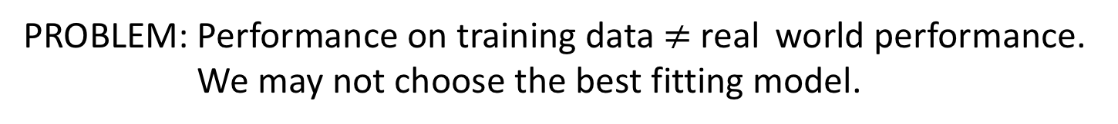
Optimising our fit to training data
We often have choices:
e.g. what fit function to use?
what predictors to include?
what predictor transformations (e.g. log) might be useful?
Look at performance of fit (i.e. minimize residuals) for each option.
Choose the best performing fit.
PROBLEM: Performance on training data $≠$real world performance. We may not choose the best fitting model.
ISSU0053 Data Science Dr Phil Lewis

Slide 16
Optimising our fit to training data
We often have choices:
e.g. what fit function to use?
what predictors to include?
what predictor transformations (e.g. log) might be useful?
Look at performance of fit (i.e. minimize residuals) for each option.
Choose the best performing fit.
PROBLEM: Performance on training data $≠$real world performance. We may not choose the best fitting model.
SOLUTION: Use measures of fit that account for overfitting:
(Adj Rsquared, AIC, BIC)
ISSUE: These are accurate only if linear fits assumptions are valid
ISSU0053 Data Science Dr Phil Lewis

Slide 17
Optimising our fit to training data
We often have choices:
e.g. what fit function to use?
what predictors to include?
what predictor transformations (e.g. log) might be useful?
Look at performance of fit (i.e. minimize residuals) for each option.
Choose the best performing fit.
PROBLEM: Performance on training data $≠$real world performance. We may not choose the best fitting model.
SOLUTION: validate performance measurements by testing on data that was not used to train the fit.
(more general)
ISSU0053 Data Science Dr Phil Lewis

